Slide 1

Sauce & Spoon
Tablet Rollout
Impact Report

Slide 2
Executive Summary
The project vision: The project met our goals of providing customers with a smooth ordering experience while also giving the restaurant a more efficient ticketing system that boosted sales and customer satisfaction, cut down on food waste through reducing comping, and reduced table turnover time.
Two key accomplishments:
Customer satisfaction increased to 86% after addressing issues on, tablet bug fixes , better staff training and reduced wait times. We achieved a 14% improvement after the test launch results
Revenue increased up to 20% after tablet implementation a result of quicker table turnover times but also increased due to Holiday season
Lessons learned:
More emphasis on effective staff training
More emphasis on Correct orders ( customer comments on orders seen by kitchen staff )
Next steps:
Continue to track customer experience and satisfaction
Expand tablet features and functionality

Slide 3
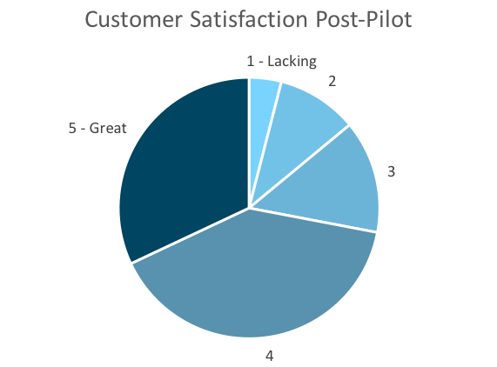
Customer Satisfaction: Pilot
Q. On a scale of 1-5, please rate your experience with the tablet overall.
This pie chart illustrates the results from the post-pilot survey.
72% of respondents indicated a customer satisfaction score of 4 or 5.
Notes:
First pie chart: Results from the post-pilot survey
Second pie chart: Results from the post-launch survey, after making changes
Satisfaction has gone up from 72% (4 and 5 rating) to 86% (4 and 5 rating)
Post-pilot data:
1 - Lacking 2 4%
2 5 10%
3 7 14%
4 20 40%
5 - Great 16 32%
Post-launch data:
1 - Lacking 1 2%
2 2 4%
3 4 8%
4 22 44%
5 - Great 21 42%

Slide 4
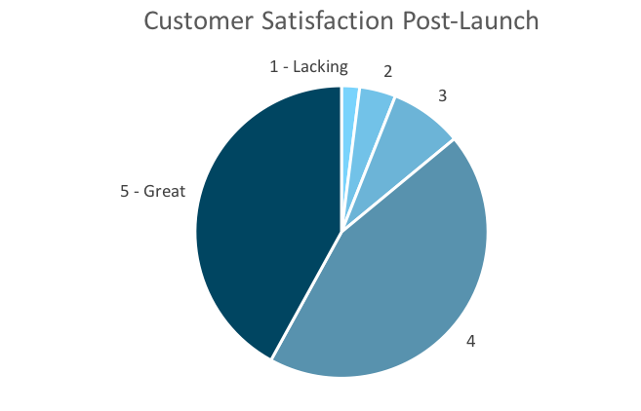
Customer Satisfaction: Launch
Q. On a scale of 1-5, please rate your experience with the tablet overall.
This pie chart illustrates the results from the post-launch survey.
86% of respondents indicated a customer satisfaction score of 4 or 5. This is a 14% increase.
Notes:
First pie chart: Results from the post-pilot survey
Second pie chart: Results from the post-launch survey, after making changes
Satisfaction has gone up from 72% (4 and 5 rating) to 86% (4 and 5 rating)
Post-pilot data:
1 - Lacking 2 4%
2 5 10%
3 7 14%
4 20 40%
5 - Great 16 32%
Post-launch data:
1 - Lacking 1 2%
2 2 4%
3 4 8%
4 22 44%
5 - Great 21 42%

Slide 5
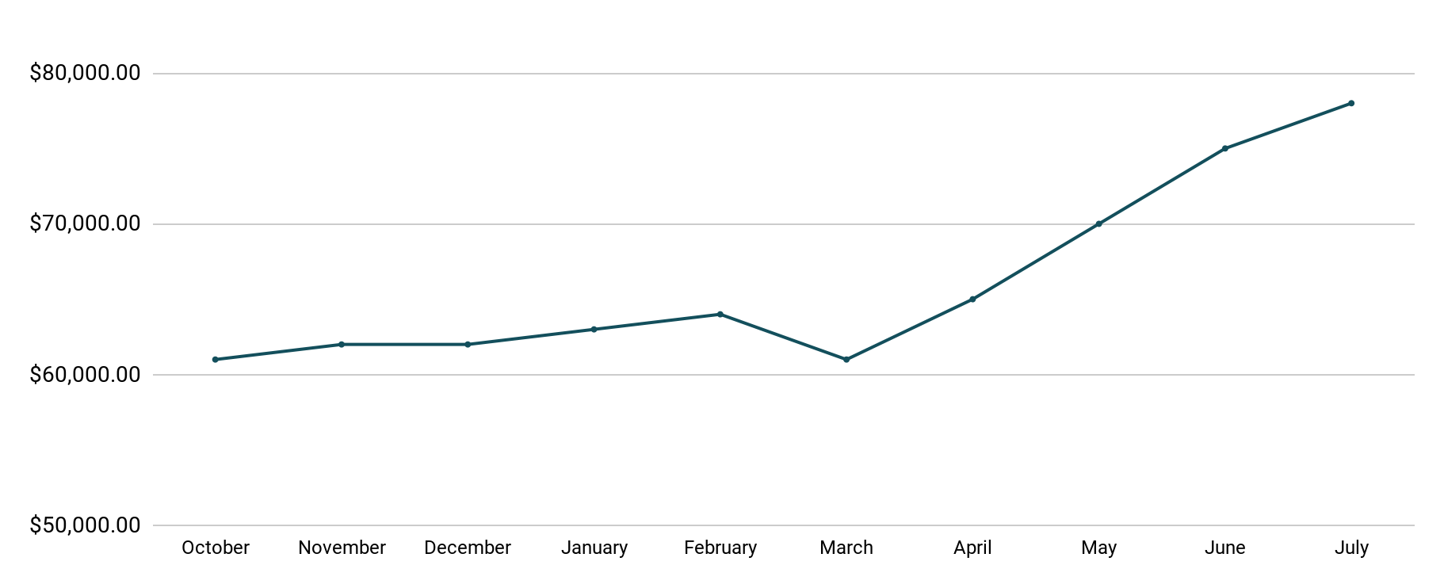
Revenue
Tablet Launch April 23
This is a chart of Sauce & Spoon revenue, showing that after tablet implementation, revenue increased.
July revenue was up to 20% over April’s monthly revenue.
Notes:
This is a chart of Sauce & Spoon revenue, showing that after tablet implementation, revenue increased. December revenue was up to 20% over September’s monthly revenue.
Sales data:
October
$61,000.00
November
$62,000.00
December
$62,000.00
January
$63,000.00
February
$64,000.00
March
$61,000.00
April
$65,000.00
May
$70,000.00
June
$75,000.00
July
$78,000.00

Slide 6
What Worked: Key Accomplishments
Decreased table turn time
Implementation of the tablets increased the average daily guest count by 10%.
Tablets also decreased wait time by 30 minutes.
Decreased food waste
Tablets identified who was receiving an incorrect order.
Kitchen staff has taken the initiative to correct orders and decrease food waste by 50%.
Increased customer satisfaction
After the pilot, customer satisfaction was at 72%.
Once we implemented improvements based on feedback, customer satisfaction increased to 86%.
Increased sales
Our monthly revenue has increased steadily since the tablet rollout, upwards of 20% since September/pre-rollout.
Tablets also helped boost revenue during the holiday season.

Slide 7
Next Steps: Looking Forward
Initiative | Action | Date
Implement tablets in more locations | Create new project plan for new location installation | Q2
Continue to track customer experience and satisfaction | Continue surveying/ gathering data through various means | Ongoing
Expand tablet features | Investigate new features like social media integration, reservations, videos, etc. | Q4

Slide 8
Appendix
Access all resources here.
Notes:
Insert link to your shared drive or a shared folder with all of the relevant project artifacts

